Slide 1



TOOL: XAMPP
Handyman At Doorstep
(S/W for hiring handyman for household works)
FS’tival-22 Software Freedom Day

Slide 2
Problem Statement
Due to lack of contacts and a new area, finding a handyman to complete household tasks can be difficult these days. To address this problem, it would be more convenient if a website is developed .
Handyman at your Doorstep(HAD) is a web-based application that assists customers in finding local service providers such as a plumber, tutor, or maid. Users may also hire their handyman according to their needs.

Slide 3
Objective
Our concept makes it easier for many people, especially senior residents, to engage handymen for home tasks.
Our website displays the information about the employees as well as the fees they charge.
We typically offer an admin panel that allows users to dynamically add or remove employees depending on the relevant circumstances.
On our website, users may also ask questions or give comments about the employees to help us provide better services.
Our project includes the employees in labeled way in order to be smooth for the customer to hire the employees.

Slide 4
Tech Stack
SERVER SIDE : PHP
DATABASE : MySQL
FRONT END : HTML,CSS,JAVASCRIPT
XAMPP
PEARL
CROSS PLATFORM
MY
SQL
Apache
PHP

Slide 5
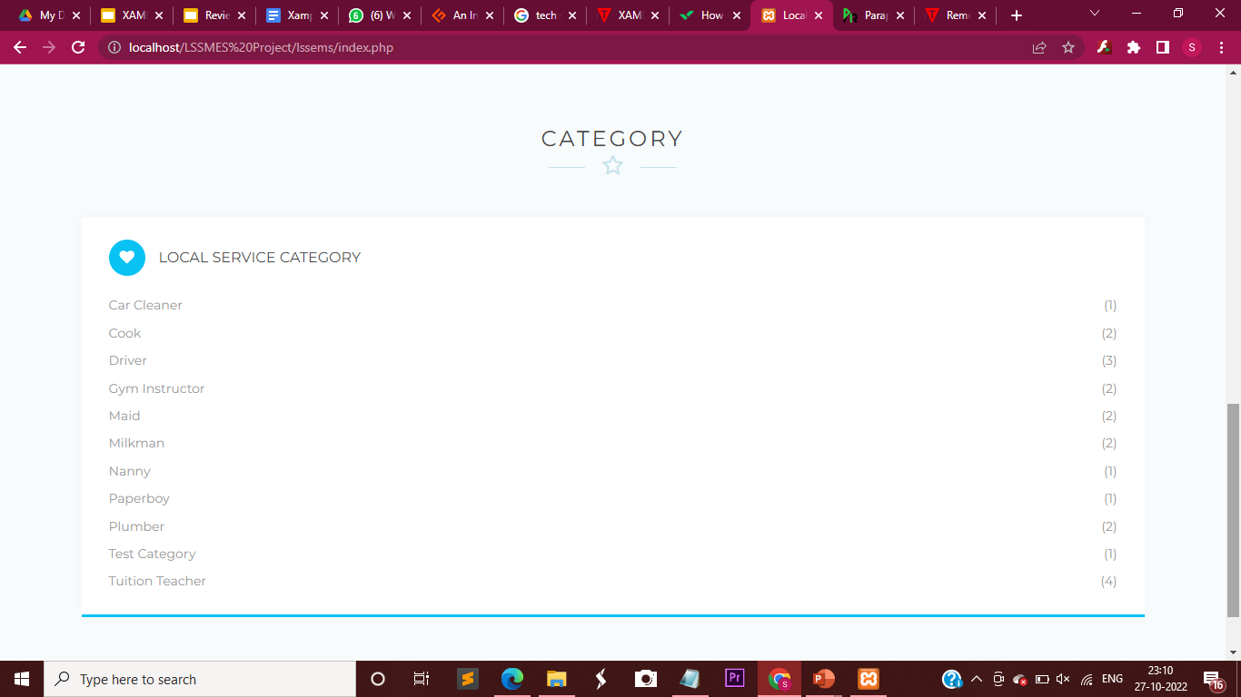
Modules
In this project, PHP and MySQL were used. This project contains two modules i.e. Admin and user.
CATEGORY:
Includes a list of workers based on their job and their numbers.

Slide 6
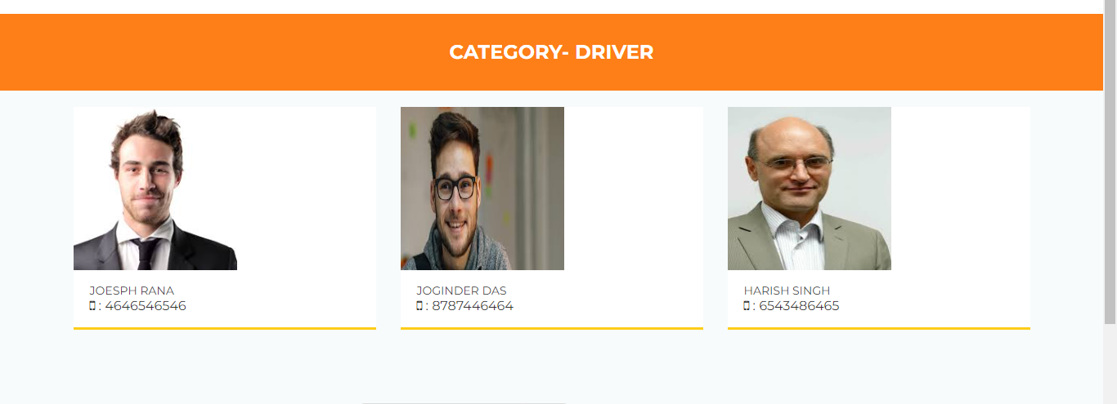
Modules

Slide 7
Modules
ADMIN:
Admin Setting: In this section, admin can update their profile, change their password, and log out.
Dashboard: In this section, admin can briefly view the total number of categories and the total number of people.
Service Category: In this section, admin can manage the category (Add/Update).
Person List: In this section, the admin can manage a person (Add/Update/Delete).
Pages: In this section, the admin can manage about us and contact us pages.
Admin can update his profile, change the password and recover the password.

Slide 8
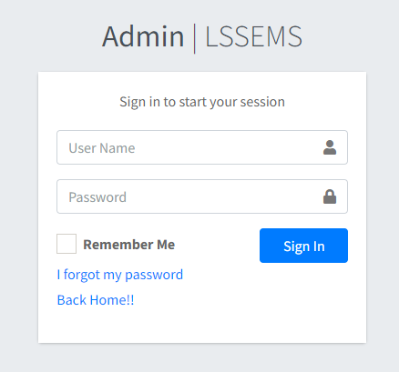
Modules

Slide 9
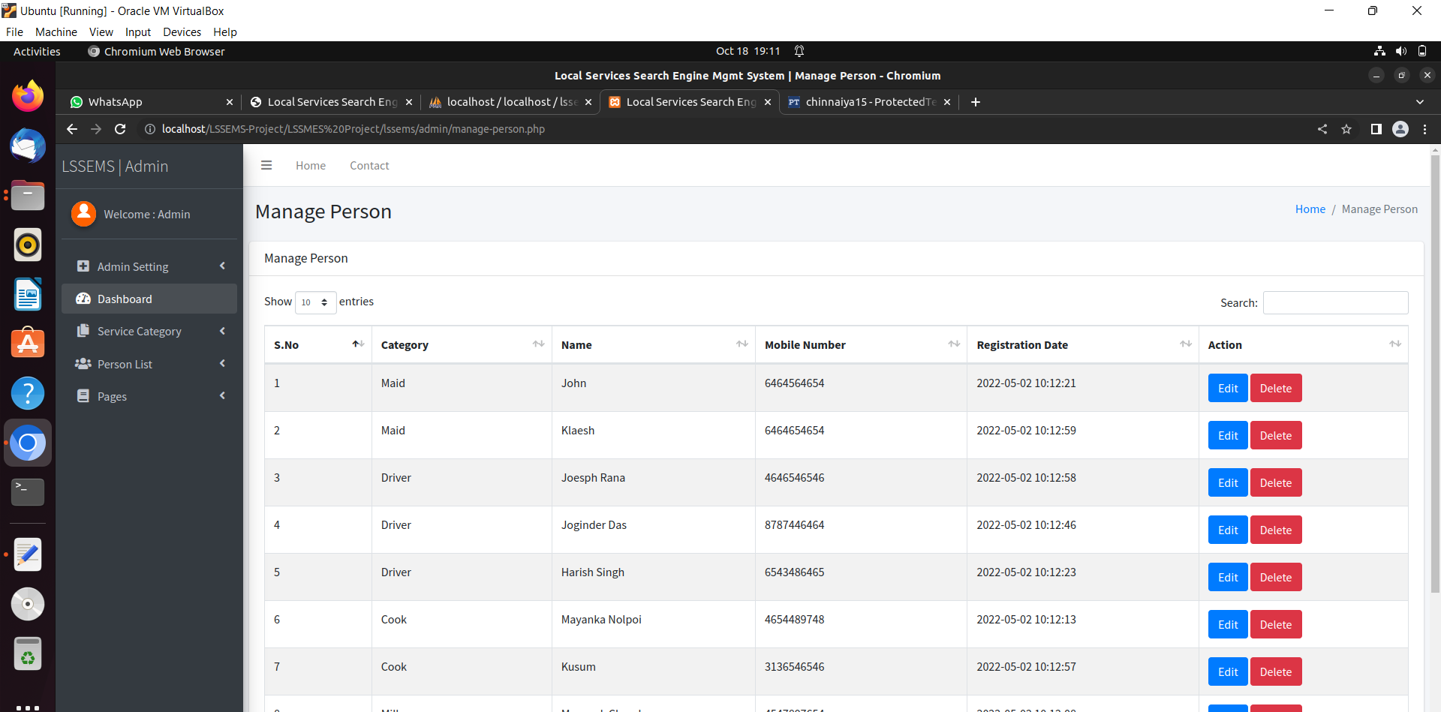
Modules

Slide 10
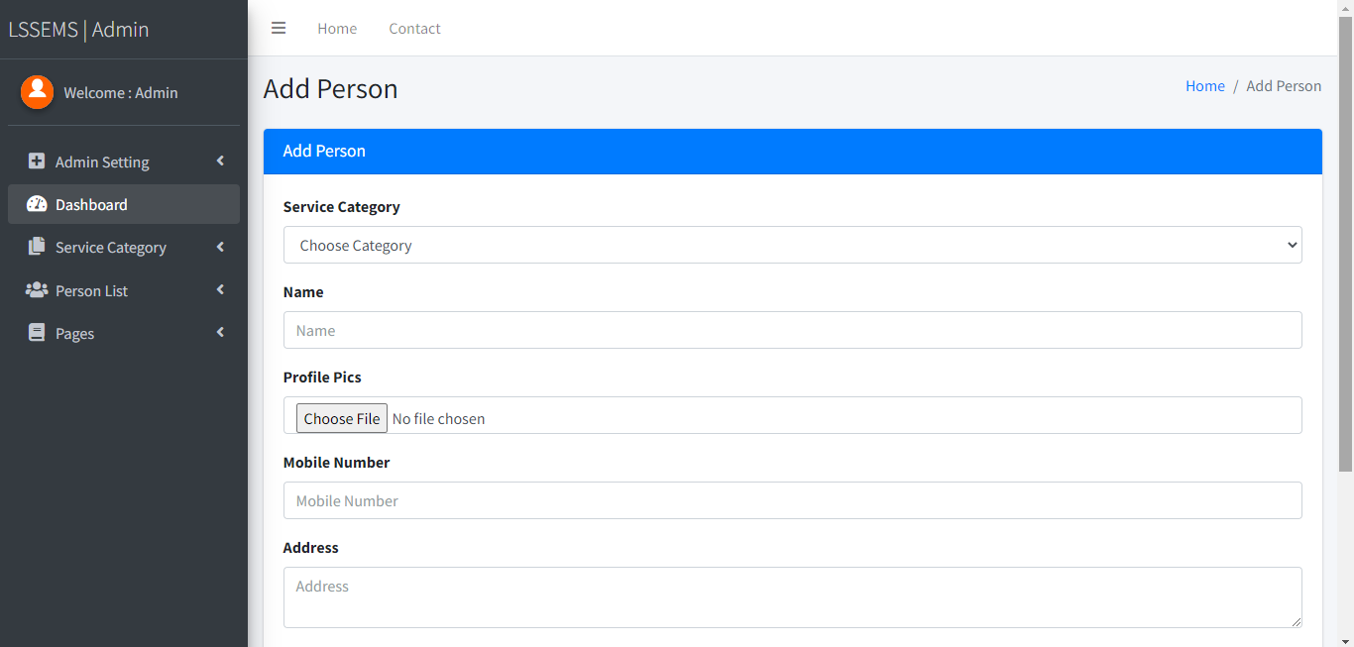
Modules

Slide 11
Thank You

